Slide 1
BFO: 2025 C-FORS Solutions

Slide 2
Case 1
In aircraft_data.xlsx you will find a row for the Airbus A320 Neo.
Construct a BFO-conformant design pattern reflecting the content of columns C-G, R-S, and AB.

Slide 3
GDC
Jet Engine
has continuant part
exactly 2
Jet Specification
Fixed Wing
is subclass of
is subclass of
has model BADA
“Airbus A320-271N”
rdf:type
Airbus 320N Spec_1
is about
has model FAA
“Airbus A320 NEO”
only
Airbus
has manufacturer
has length ft
has tail height
at OEW ft
“123.3”xsd:dec
“39.6”xsd:dec

Slide 4
GDC
Jet Engine
has continuant part
exactly 2
Jet Specification
Fixed Wing
is subclass of
is subclass of
has model BADA
“Airbus A320-271N”
rdf:type
Airbus 320N Spec_1
is about
has model FAA
“Airbus A320 NEO”
only
Airbus
has manufacturer
has length ft
Airbus 320N Spec_1 is about only the class C defined as equivalent to the
intersection of...
has tail height
at OEW ft
“123.3”xsd:dec
“39.6”xsd:dec

Slide 5
GDC
Jet Engine
has continuant part
exactly 2
Jet Specification
Fixed Wing
is subclass of
is subclass of
has model BADA
“Airbus A320-271N”
rdf:type
Airbus 320N Spec_1
is about
has model FAA
“Airbus A320 NEO”
only
COLUMN C
Airbus
has manufacturer
has length ft
has tail height
at OEW ft
“123.3”xsd:dec
“39.6”xsd:dec

Slide 6
GDC
Jet Engine
has continuant part
exactly 2
Jet Specification
Fixed Wing
is subclass of
is subclass of
has model BADA
“Airbus A320-271N”
rdf:type
Airbus 320N Spec_1
is about
has model FAA
“Airbus A320 NEO”
COLUMN D
only
Airbus
has manufacturer
has length ft
has tail height
at OEW ft
“123.3”xsd:dec
“39.6”xsd:dec

Slide 7
GDC
Jet Engine
has continuant part
exactly 2
Jet Specification
Fixed Wing
is subclass of
is subclass of
COLUMN E
has model BADA
“Airbus A320-271N”
rdf:type
Airbus 320N Spec_1
is about
has model FAA
“Airbus A320 NEO”
only
Airbus
has manufacturer
has length ft
has tail height
at OEW ft
“123.3”xsd:dec
“39.6”xsd:dec

Slide 8
GDC
Jet Engine
COLUMN F
has continuant part
exactly 2
Jet Specification
Fixed Wing
is subclass of
is subclass of
has model BADA
“Airbus A320-271N”
rdf:type
Airbus 320N Spec_1
is about
has model FAA
“Airbus A320 NEO”
only
Airbus
has manufacturer
has length ft
has tail height
at OEW ft
“123.3”xsd:dec
“39.6”xsd:dec

Slide 9
GDC
Jet Engine
has continuant part
exactly 2
COLUMN G
Fixed Wing
Jet Specification
is subclass of
is subclass of
has model BADA
“Airbus A320-271N”
rdf:type
Airbus 320N Spec_1
is about
has model FAA
“Airbus A320 NEO”
only
Airbus
has manufacturer
has length ft
has tail height
at OEW ft
“123.3”xsd:dec
“39.6”xsd:dec

Slide 10
GDC
Jet Engine
has continuant part
exactly 2
Jet Specification
Fixed Wing
is subclass of
is subclass of
has model BADA
“Airbus A320-271N”
rdf:type
Airbus 320N Spec_1
is about
has model FAA
“Airbus A320 NEO”
only
Airbus
has manufacturer
has length ft
has tail height
at OEW ft
“123.3”xsd:dec
COLUMN R
“39.6”xsd:dec

Slide 11
GDC
GDC
Jet Engine
has continuant part
exactly 2
Jet Specification
Fixed Wing
Jet Specification
is subclass of
is subclass of
has model BADA
“Airbus A320-271N”
rdf:type
Airbus 320N Spec_1
is about
has model FAA
“Airbus A320 NEO”
only
Airbus
has manufacturer
has length ft
has tail height
at OEW ft
“123.3”xsd:dec
“39.6”xsd:dec
COLUMN S

Slide 12
GDC
Jet Engine
has continuant part
exactly 2
COLUMN AB
Jet Specification
Fixed Wing
is subclass of
is subclass of
has model BADA
“Airbus A320-271N”
rdf:type
Airbus 320N Spec_1
is about
has model FAA
“Airbus A320 NEO”
only
Airbus
has manufacturer
has length ft
has tail height
at OEW ft
“123.3”xsd:dec
“39.6”xsd:dec

Slide 13
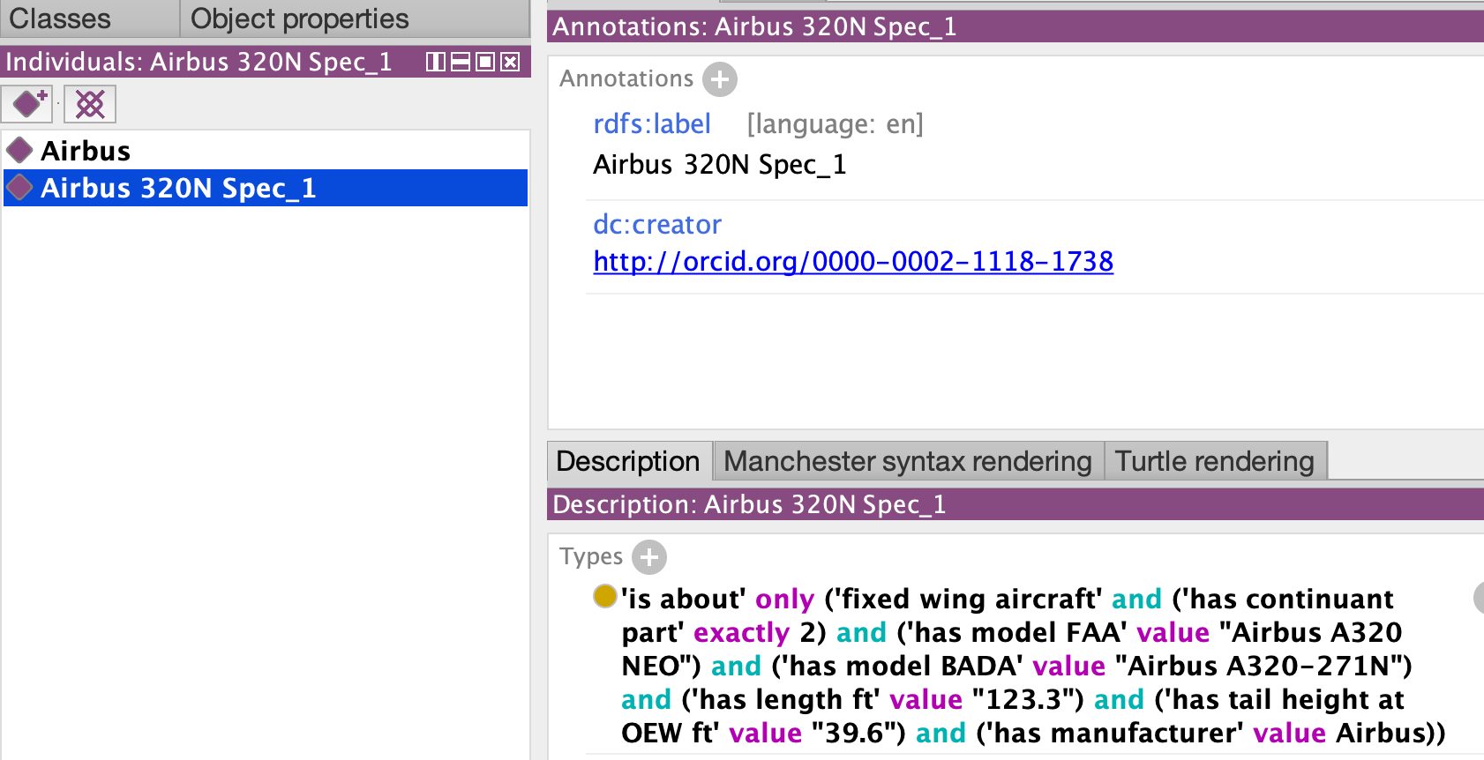

Slide 14
Case 2
In aircraft_data.xlsx you will find a row for the Airbus A321-111, designed to have a maximum knot approach speed of 142. However, after 5 approaches, an instance has obtained an average maximum knot approach speed of 139.
Construct a BFO-conformant design pattern reflecting the preceding phenomena.

Slide 15
Jet Specification
rdf:type
Airbus 320N Spec_1
“142”xsd:dec
is about
max approach speed knot
Fixed Wing
only
subclass of

Slide 16
Jet Specification
SPEC PRESCRIBES
SOME ANON CLASS
rdf:type
Airbus 320N Spec_1
“142”xsd:dec
is about
max approach speed knot
Fixed Wing
only
subclass of

Slide 17
Jet Specification
rdf:type
Airbus 320N Spec_1
“142”xsd:dec
is about
max approach speed knot
Fixed Wing
only
subclass of
rdf:type
Airbus 320N_1
WHICH HAS A
FIXED WING INSTANCE

Slide 18
Jet Specification
rdf:type
Airbus 320N Spec_1
“142”xsd:dec
is about
max approach speed knot
Fixed Wing
only
subclass of
rdf:type
test_ process
Airbus 320N_1
participates in
THAT PARTICIPATES IN
AN OVERALL TEST PROCESS

Slide 19
Jet Specification
rdf:type
Process
Airbus 320N Spec_1
“142”xsd:dec
is about
max approach speed knot
Fixed Wing
only
rdf:type
subclass of
approach_part_1
approach_part_2
rdf:type
approach_part_3
test_ process
Airbus 320N_1
participates in
approach_part_4
approach_part_5
temporal
part of
WHICH HAS
TEMPORAL PARTS

Slide 20
Jet Specification
THAT ARE
MEASURED
rdf:type
GDC
Process
Airbus 320N Spec_1
“142”xsd:dec
is about
max approach speed knot
Fixed Wing
only
rdf:type
rdf:type
subclass of
approach_part_1
msr_1
approach_part_2
rdf:type
msr_2
approach_part_3
test_ process
Airbus 320N_1
msr_3
participates in
approach_part_4
msr_4
approach_part_5
msr_5
temporal
part of
is about

Slide 21
GDC
Process
approach_part_1
msr_1
“”xsd:int
approach_part_2
msr_2
SUPPOSE WE HAVE
MEASUREMENT
VALUES
approach_part_3
“”xsd:int
msr_3
“”xsd:int
approach_part_4
msr_4
approach_part_5
“”xsd:int
msr_5
“”xsd:int
has measurement
value
is about

Slide 22
GDC
Process
approach_part_1
msr_1
“”xsd:int
approach_part_2
USE SPARQL
TO CALCULATE
AND RETURN
THE AVERAGE
msr_2
approach_part_3
“”xsd:int
msr_3
“”xsd:int
approach_part_4
msr_4
approach_part_5
“”xsd:int
msr_5
“”xsd:int
has measurement
value
is about

Slide 23
GDC
Process
rdf:type
rdf:type
approach_part_1
msr_1
“”xsd:int
approach_part_2
msr_2
approach_part_3
test_ process
“”xsd:int
msr_3
“”xsd:int
approach_part_4
msr_4
approach_part_5
“”xsd:int
msr_5
temporal
part of
“”xsd:int
AVG OF
TEST
PROCESS
is about
is about
GDC
avg_1
“139”xsd:int
rdf:type
has measurement
value

Slide 24
Case 3
In soc_structure_definitions.xlsx you will find three “SOC_TITLE” entries that mention “Aerospace Engineer”.
Construct a BFO-conformant design pattern that reflects all three entries and their respective “SOC Definitions”.

Slide 25

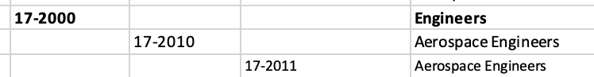


Slide 26
US SOC Data Structure
Level | Digits | Example | Description
Major Group | 2 digits | 15-0000 | Very broad category (e.g., Computer and Mathematical Occupations)
Minor Group | 4 digits | 15-1200 | Subcategory under major group (e.g., Computer Occupations)
Broad Occupation | 5 digits | 15-1250 | A grouping of related detailed occupations (e.g., Software and Web Developers)
Detailed Occupation | 6 digits | 15-1252 | A specific job type (e.g., Software Developers)

Slide 27
US SOC Data Structure
Level | Digits | Example | Description
Major Group | 2 digits | 15-0000 | Very broad category (e.g., Computer and Mathematical Occupations)
Minor Group | 4 digits | 15-1200 | Subcategory under major group (e.g., Computer Occupations)
Broad Occupation | 5 digits | 15-1250 | A grouping of related detailed occupations (e.g., Software and Web Developers)
Detailed Occupation | 6 digits | 15-1252 | A specific job type (e.g., Software Developers)

Slide 28
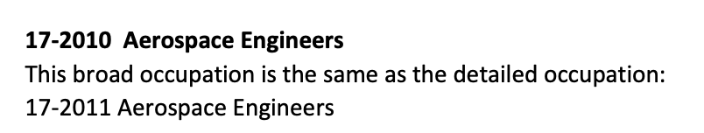
Broad & Detailed
You will need to learn to deal with confusing data:
Always research:
https://www.bls.gov/soc/2018/soc_2018_manual.pdf

Slide 29
Aerospace Engineer
Perform engineering duties in designing, constructing, and testing aircraft, missiles, and spacecraft. May conduct basic and applied research to evaluate adaptability of materials and equipment to aircraft design and manufacture. May recommend improvements in testing equipment and techniques.

Slide 30
GDC
SOC CODE
is subclass of
Act of Aircraft Design
Aircraft Spec
rdf:type
output of
SOC_1
bearer of
realizes
Adaptability Evaluation
is about
Job Role
Report
only
output of
Recommending
Equip Test
output of

Slide 31
GDC
SOC CODE
is subclass of
Act of Aircraft Design
Aircraft Spec
rdf:type
output of
SOC_1
bearer of
realizes
Adaptability Evaluation
is about
Job Role
Report
only
output of
Recommending
Equip Test
SOC_1 CODE IS
ABOUT ONLY
ANON CLASS
output of

Slide 32
GDC
INSTANCES OF WHICH ARE
BEARERS OF SOME
JOB ROLE
SOC CODE
is subclass of
Act of Aircraft Design
Aircraft Spec
rdf:type
output of
SOC_1
bearer of
realizes
Adaptability Evaluation
is about
Job Role
Report
only
output of
Recommending
Equip Test
output of

Slide 33
GDC
SOC CODE
is subclass of
Act of Aircraft Design
Aircraft Spec
WHICH IF
REALIZED
rdf:type
output of
SOC_1
bearer of
realizes
Adaptability Evaluation
is about
Job Role
Report
only
output of
ARE REALIZED IN...
Recommending
Equip Test
output of

Slide 34
GDC
SOC CODE
is subclass of
Act of Aircraft Design
Aircraft Spec
rdf:type
output of
SOC_1
OR
bearer of
realizes
Adaptability Evaluation
is about
Job Role
Report
only
output of
OR
Recommending
Equip Test
output of

Slide 35
GDC
AND, SAY, ANY EQUIPMENT TEST IS OUTPUT OF SOME ACT OF EQUIPMENT RECOMMENDATION
SOC CODE
is subclass of
Act of Aircraft Design
Aircraft Spec
rdf:type
output of
SOC_1
bearer of
realizes
Adaptability Evaluation
is about
Job Role
Report
only
output of
Recommending
Equip Test
output of

Slide 36
Case 4
In employment_wage_May_2024.xlsx you will find three “OCC_TITLE” entries that mention “Aerospace Engineer”.
Construct a BFO-conformant design pattern that reflects all three entries and their associated columns A, H, I, K, L.

Slide 37
GDC
“Aerospace
Engineer”
“broad”
is subclass of
SOC Code
“Aerospace Engineering
and Operations
Technologists and
Technicians”
rdfs:label
o group
“Aerospace
Engineer”
rdf:type
SOC_code_1
SOC_code_2
SOC_code_3
rdfs:label
rdfs:label
o group
o group
“detailed”
has area
has area
“detailed”
has area
own
code
own
code
own
code
“99”
occ
code
“99”
occ
code
“99”
occ
code
“1235”
“1235”
“1235”
“17-3021”
“17-2020”
“17-2011”

Slide 38
BLAH
BLAH
GDC
“Aerospace
Engineer”
“broad”
is subclass of
SOC Code
“Aerospace Engineering
and Operations
Technologists and
Technicians”
rdfs:label
o group
“Aerospace
Engineer”
rdf:type
SOC_code_1
SOC_code_2
SOC_code_3
rdfs:label
rdfs:label
o group
o group
“detailed”
has area
has area
“detailed”
has area
own
code
own
code
own
code
“99”
occ
code
“99”
occ
code
“99”
occ
code
“1235”
“1235”
“1235”
“17-3021”
“17-2020”
“17-2011”

Slide 39
MORE
ANNOTATIONS
GDC
“Aerospace
Engineer”
“broad”
is subclass of
SOC Code
“Aerospace Engineering
and Operations
Technologists and
Technicians”
rdfs:label
o group
“Aerospace
Engineer”
rdf:type
SOC_code_1
SOC_code_2
SOC_code_3
rdfs:label
rdfs:label
o group
o group
“detailed”
has area
has area
“detailed”
has area
own
code
own
code
own
code
“99”
occ
code
“99”
occ
code
“99”
occ
code
“1235”
“1235”
“1235”
“17-3021”
“17-2020”
“17-2011”

Slide 40
ANYTHING
INTERESTING?
GDC
“Aerospace
Engineer”
“broad”
is subclass of
SOC Code
“Aerospace Engineering
and Operations
Technologists and
Technicians”
rdfs:label
o group
“Aerospace
Engineer”
rdf:type
SOC_code_1
SOC_code_2
SOC_code_3
rdfs:label
rdfs:label
o group
o group
“detailed”
has area
has area
“detailed”
has area
own
code
own
code
own
code
“99”
occ
code
“99”
occ
code
“99”
occ
code
“1235”
“1235”
“1235”
“17-3021”
“17-2020”
“17-2011”

Slide 41
ANYTHING
INTERESTING?
GDC
“Aerospace
Engineer”
“broad”
is subclass of
SOC Code
“Aerospace Engineering
and Operations
Technologists and
Technicians”
rdfs:label
o group
“Aerospace
Engineer”
rdf:type
SOC_code_1
SOC_code_2
SOC_code_3
rdfs:label
rdfs:label
o group
o group
“detailed”
has area
has area
“detailed”
has area
own
code
own
code
own
code
“99”
occ
code
“99”
occ
code
“99”
occ
code
“1235”
“1235”
“1235”
“17-3021”
“17-2020”
“17-2011”

Slide 42
ANYTHING
INTERESTING?
GDC
“Aerospace
Engineer”
“broad”
is subclass of
SOC Code
“Aerospace Engineering
and Operations
Technologists and
Technicians”
rdfs:label
o group
“Aerospace
Engineer”
rdf:type
SOC_code_1
SOC_code_2
SOC_code_3
rdfs:label
rdfs:label
o group
o group
“detailed”
has area
has area
“detailed”
has area
own
code
own
code
own
code
“99”
occ
code
“99”
occ
code
“99”
occ
code
“1235”
“1235”
“1235”
“17-3021”
“17-2020”
“17-2011”

Slide 43
ANYTHING
INTERESTING?
GDC
“Aerospace
Engineer”
“broad”
is subclass of
SOC Code
“Aerospace Engineering
and Operations
Technologists and
Technicians”
rdfs:label
o group
“Aerospace
Engineer”
rdf:type
SOC_code_1
SOC_code_2
SOC_code_3
rdfs:label
rdfs:label
o group
o group
“detailed”
has area
has area
“detailed”
has area
own
code
own
code
own
code
“99”
occ
code
“99”
occ
code
“99”
occ
code
“1235”
“1235”
“1235”
“17-3021”
“17-2020”
“17-2011”

Slide 44
CHECK THE
OTHER XLSX...
GDC
“Aerospace
Engineer”
“broad”
is subclass of
SOC Code
“Aerospace Engineering
and Operations
Technologists and
Technicians”
rdfs:label
o group
“Aerospace
Engineer”
rdf:type
SOC_code_1
SOC_code_2
SOC_code_3
rdfs:label
rdfs:label
o group
o group
“detailed”
has area
has area
“detailed”
has area
own
code
own
code
own
code
“99”
occ
code
“99”
occ
code
“99”
occ
code
“1235”
“1235”
“1235”
“17-3021”
“17-2020”
“17-2011”

Slide 45
“Aerospace Engineering
and Operations
Technologists and
Technicians”
SOC_code_1
rdfs:label
o group
“detailed”
has area
own
code
“99”
occ
code
“1235”
“17-3021”

Slide 46
GDC
rdf:type
“Aerospace Engineering
and Operations
Technologists and
Technicians”
has tot emp
tot_emp
“9060”
pop
rdf:type
Object Aggregate
continuant part of
SOC_code_1
is about
rdfs:label
o group
outputs
inheres in
act of msr
input of
count
Quality
“detailed”
has area
own
code
rdf:type
“99”
occ
code
rdf:type
“1235”
Process
“17-3021”

Slide 47
GDC
THERE IS A
POPULATION
rdf:type
“Aerospace Engineering
and Operations
Technologists and
Technicians”
has tot emp
tot_emp
“9060”
pop
rdf:type
Object Aggregate
continuant part of
SOC_code_1
is about
rdfs:label
o group
outputs
inheres in
act of msr
input of
count
Quality
“detailed”
has area
own
code
rdf:type
“99”
occ
code
rdf:type
“1235”
Process
“17-3021”

Slide 48
GDC
rdf:type
“Aerospace Engineering
and Operations
Technologists and
Technicians”
has tot emp
tot_emp
“9060”
pop
rdf:type
Object Aggregate
continuant part of
SOC_code_1
is about
rdfs:label
o group
outputs
inheres in
act of msr
input of
count
Quality
“detailed”
has area
own
code
rdf:type
“99”
occ
code
rdf:type
BEARING A
QUALITY
“1235”
Process
“17-3021”

Slide 49
GDC
rdf:type
“Aerospace Engineering
and Operations
Technologists and
Technicians”
has tot emp
tot_emp
“9060”
pop
rdf:type
Object Aggregate
continuant part of
SOC_code_1
is about
rdfs:label
o group
outputs
inheres in
act of msr
input of
count
Quality
“detailed”
has area
own
code
rdf:type
“99”
occ
code
rdf:type
“1235”
Process
WHICH IS INPUT TO
AN ACT OF MEASURING
“17-3021”

Slide 50
GDC
THAT IN TURN OUTPUTS
TO TOTAL EMPLOYMENT
INFORMATION
rdf:type
“Aerospace Engineering
and Operations
Technologists and
Technicians”
has tot emp
tot_emp
“9060”
pop
rdf:type
Object Aggregate
continuant part of
SOC_code_1
is about
rdfs:label
o group
outputs
inheres in
act of msr
input to
count
Quality
“detailed”
has area
own
code
rdf:type
“99”
occ
code
rdf:type
“1235”
Process
“17-3021”

Slide 51
WHICH HAS
COUNT OF 9060
GDC
rdf:type
“Aerospace Engineering
and Operations
Technologists and
Technicians”
has tot emp
tot_emp
“9060”
pop
rdf:type
Object Aggregate
continuant part of
SOC_code_1
is about
rdfs:label
o group
outputs
inheres in
act of msr
input to
count
Quality
“detailed”
has area
own
code
rdf:type
“99”
occ
code
rdf:type
“1235”
Process
“17-3021”

Slide 52
AND IS CONTINUANT
PART OF THE SOC CODE
GDC
rdf:type
“Aerospace Engineering
and Operations
Technologists and
Technicians”
has tot emp
tot_emp
“9060”
pop
rdf:type
Object Aggregate
continuant part of
SOC_code_1
is about
rdfs:label
o group
outputs
inheres in
act of msr
input to
count
Quality
“detailed”
has area
own
code
rdf:type
“99”
occ
code
rdf:type
“1235”
Process
“17-3021”

Slide 53
CLOSING REMARKS

Slide 54

UB Applied Ontology
In Fall 2025, UB will enroll the first class of applied ontology PhD and MS students
At present count, we have an entering class of 20 PhDs and 15 MS students
The program is entirely remote and asynchronous

Slide 55


MIT Model
That said, all of our education material will remain accessible online: https://github.com/Applied-Ontology-Education

Slide 56


Slide 57
Community Effort
Fidelity (Knowledge Representation Group)
University of Michigan (Bioinformatics)
Florida State University (Information)
Johns Hopkins Applied Physics Lab
University of Virginia (Data Science)
Department of Homeland Security
Customs and Border Protection
Knowledge Graph Alliance
Syracuse University (CSE)
Air Force Research Labs
CUBRC
KadSci
George Mason University (C4l & Cyber)
Northwestern University (Philosophy)
University of Maryland (Physics)
Industrial Ontologies Foundry
Colgate University (Philosophy)
UB (Bioinformatics Department)
Ohio State University (Logic)
UB (CSE Department)
Bloomberg (HR)
Aerospace
Scania

Slide 58
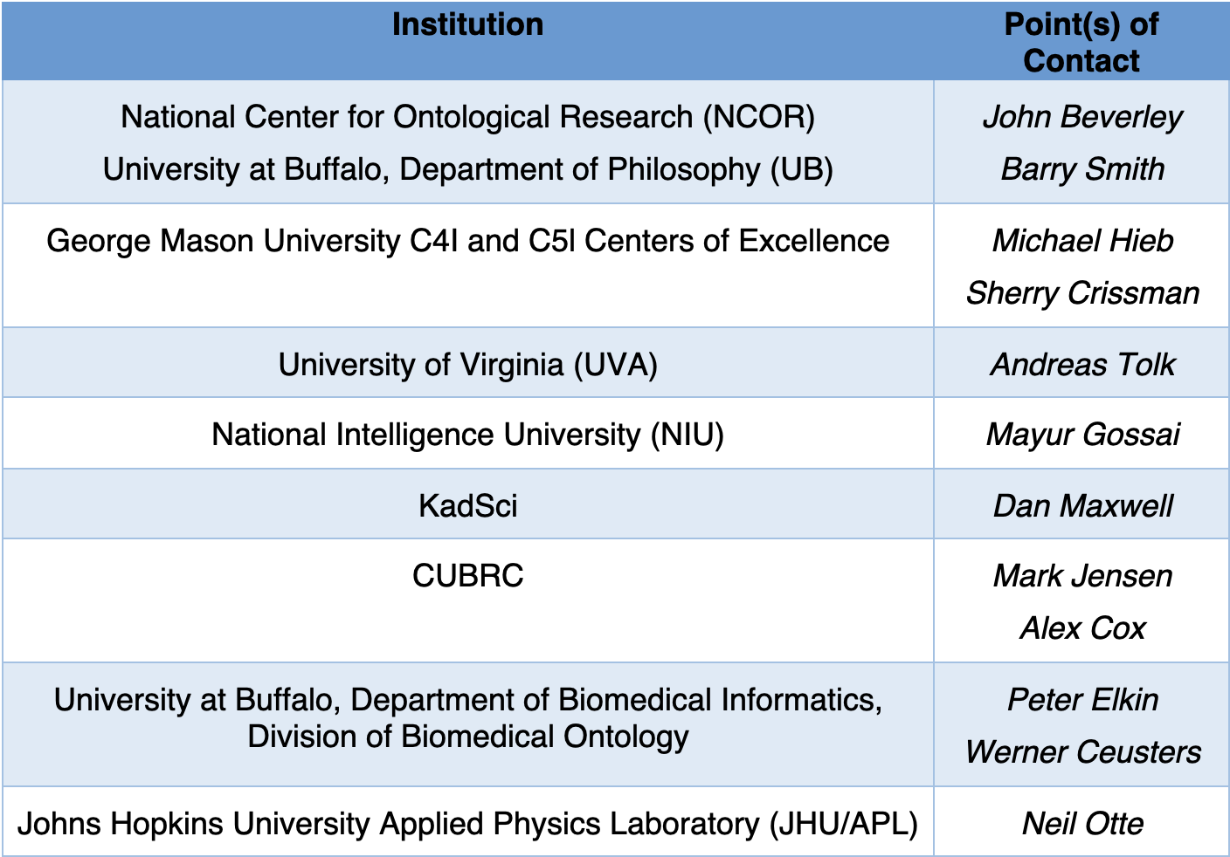
Community Effort
Create a training consortium
Whose members may:
Enter articulation agreements
Supervise new ontologists
Host tutorials, bootcamps, certificates, full programs, etc.
Provide internships
Disseminate training material and documentation for existing and future ontology training

